Slide 1
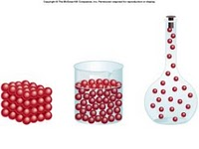
Density Part II
Measuring Volume by Displacement

Slide 2
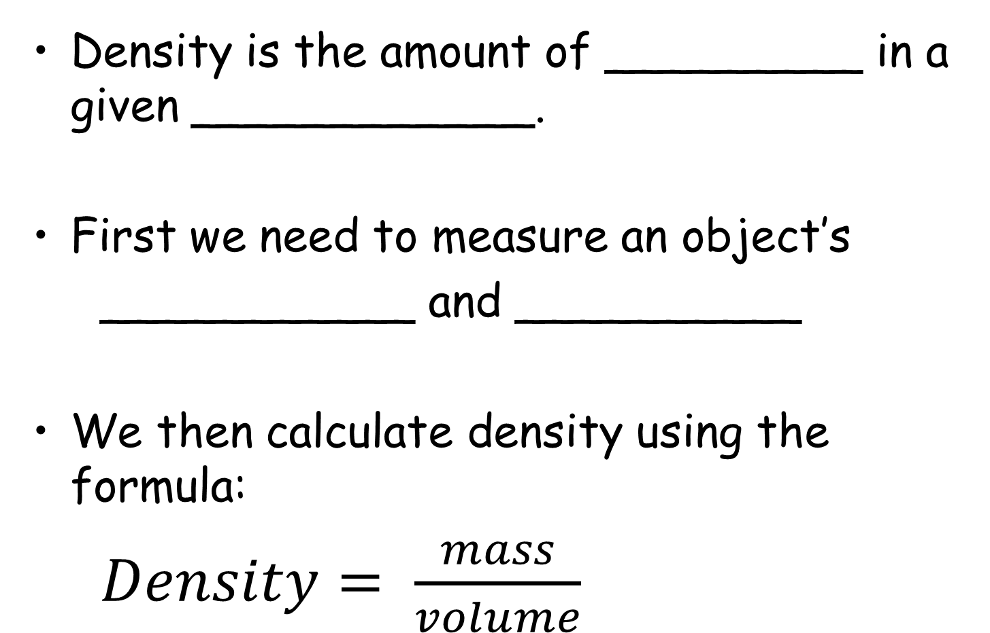
Recap: Calculating Density
matter
Density is the amount of _________ in a given ____________.
First we need to measure an object’s
___________ and __________
We then calculate density using the formula:
$Density= \frac{mass}{volume}$
volume
mass
volume
m
D
V

Slide 3
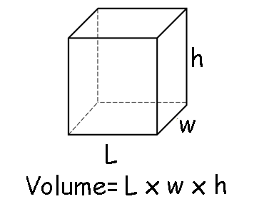
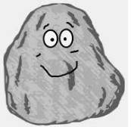
Finding Volume
Calculate using formulas:
Example:
2. Place in water and measure the ______________ .This is the ONLY method for measuring the volume of _________ objects like a
rock.
displaced water
irregular

Slide 4
Volume Displacement
displaces
A solid __________ a matching volume of water when placed in water.
Example: A metal block block has a volume of 10 mL. When it is placed in the cylinder, the water level rises from 25 mL to _______ mL.
35 mL
25 mL
35

Slide 5
Volume Displacement- Example 2
What is the volume of the rock?
Example: When the rock is placed in the cylinder, the water level rises from 20 ml to 32 ml. The volume of the rock is:
_______________
32 mL
20 mL
32 mL-20 mL= 12 mL

Slide 6
Learning Check
A metal block has a mass of 48 g. If it causes the level of water in a graduated cylinder to rise from 25 mL to 33 mL, what is the block’s volume and density?
A) 0.20 g/ cm³ B) 6.0 g/m³ C) 252 g/cm³
G → m=48.0g
V₂= 33.0 mL V₁=25.0 mL
R→ V=? d=?
33.0 mL
A→ Vol=33 – 25 = 8.0 mL
D=m/v
=48g/8.0ml
S→ =6.0g/ml
S→ the density is 6.0g/ml
25.0 mL

Slide 7
Density fun: liquid layers
http://www.youtube.com/watch?v=-CDkJuo_LYs
Liquids with different densities form ______
The liquid with the lowest density will be on the ______.
The liquid with the highest density will be on the ________.
layers
top
bottom

Slide 8
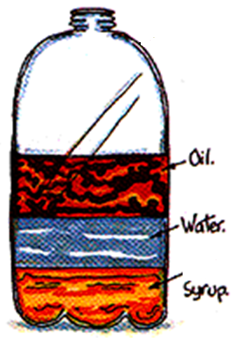
Liquid Layers
Which liquid has the
highest density?
_________
Which liquid has the
lowest density?
_________
Which liquid has the
middle density?
___________
syrup
Lowest
density
oil
Highest
density
water

Slide 9
Review
What is the formula for density?
What happens if you pour together liquids that have different densities?
Will the liquid on the top have the highest or lowest density?

Slide 10
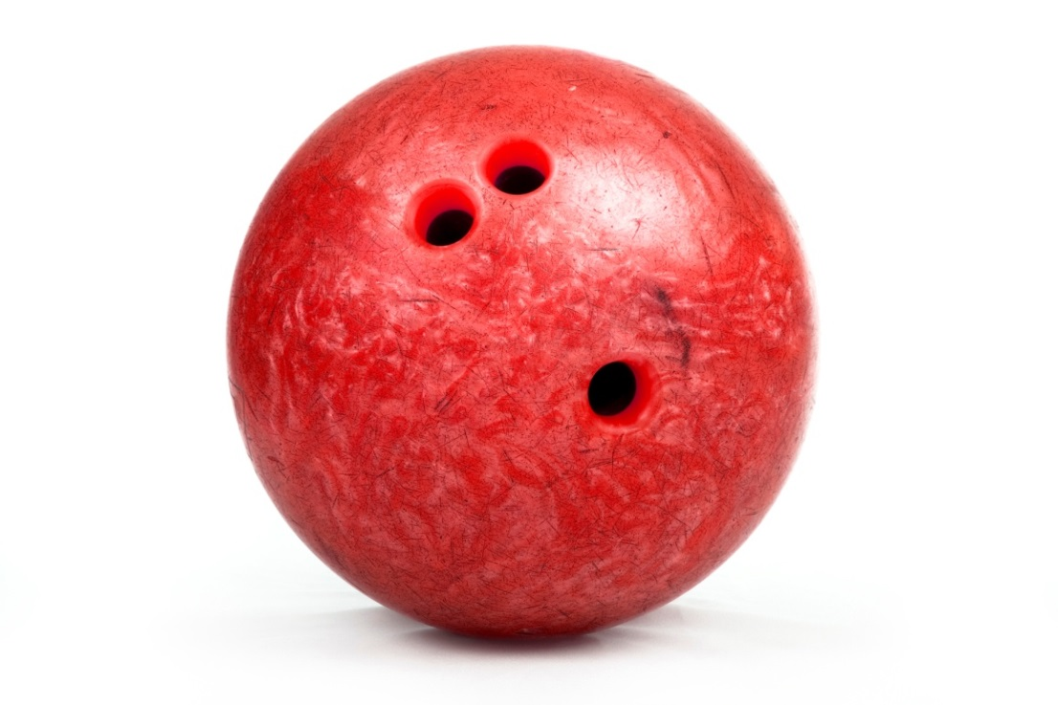
What would happen????
If you put a bowling ball in water?
http://www.youtube.com/watch?v=Lwc6QklQGFw
Prediction: Sink or float?
Notes:
Sinking vial - make it float

Slide 11
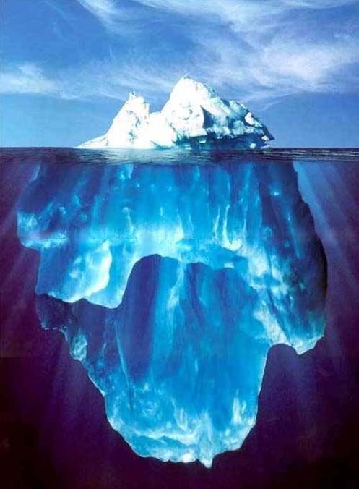
Solids in Liquids
Why does ice float in water?
Answer: _________________________
__________________________
Because ice is less dense than water!
Notes:
Beans/ping pong ball; Big jug of water in a pool

Slide 12
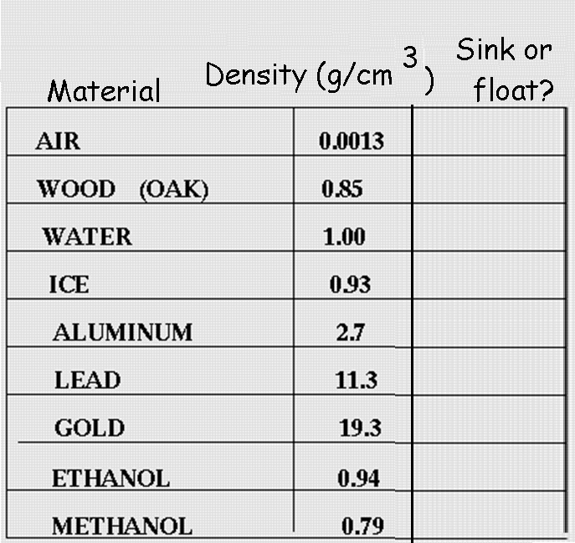
SINK or FLOAT In Water?
Float
Float
Float
Lower densities will float,higher will sink
Sink
Sink
Sink
Float
Float
Float

